Slide 1
SI206
Discussion 10
APIs

Slide 2
Objective
The purpose of today’s section is to get familiar with API and JSON. You will:
Create an API request
Get familiar with a browser-based JSON viewer
Analyze nested data
Do plenty of debugging

Slide 3
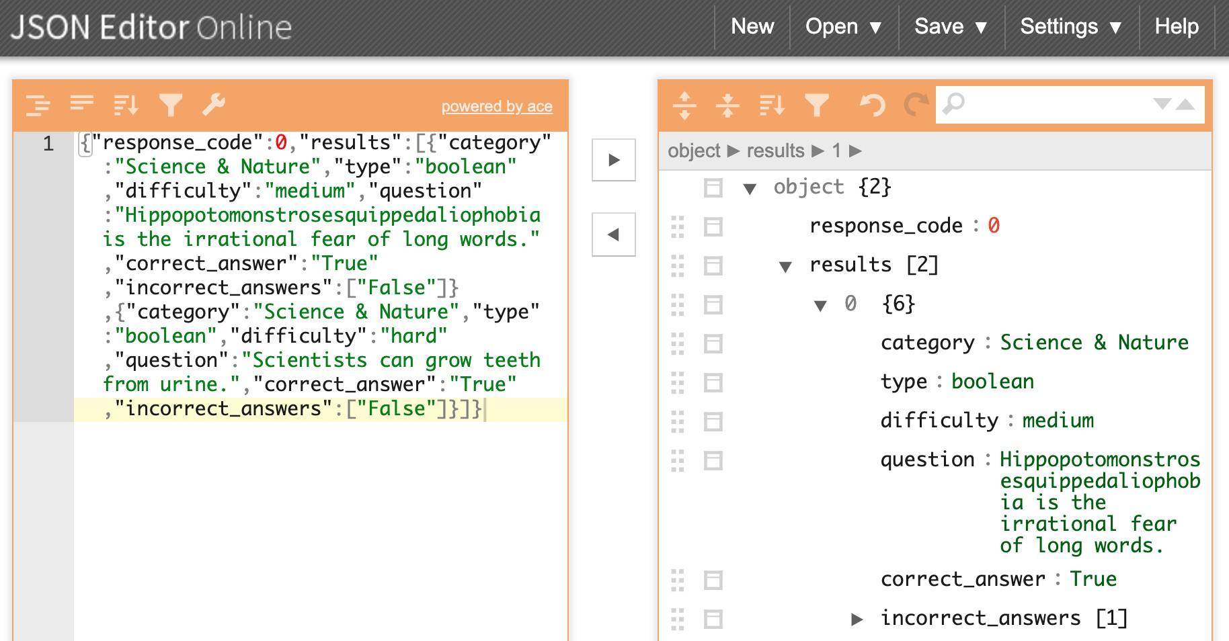
JSON Editor Online : https://jsoneditoronline.org
It’s super helpful to see the structure in a readable format that you can manipulate
Opening the JSON file in VSCode might help, too!

Slide 4
Today’s Task (more detail in starter code)
Use the World Bank API and get gdp for different countries
Demo:
Write a function get_gdp(country_code, date) that takes a country code (e.g. USA, BRA) and a date in years (e.g. 2017) that returns the value as an integer.
TASK 1:
Write a function get_data(country_code, first_year, second_year) that takes a country code (e.g. USA, BRA) and two consecutive years (e.g. 2004 and 2005) that returns the data from the API after converting it to a python list.
TASK 2:
Write a function gdp_growth(country_code, first_year, second_year) that calls get_data(country_code, first_year, second_year) and returns the GDP growth of the country for the two years in a tuple.

Slide 5
DEMO
Walking through how to solve get_gdp()
Craft URL
http://api.worldbank.org/v2/country/USA/indicator/NY.GDP.MKTP.CD?format=json&date=2020
Retrieve JSON
Parse JSON
https://jsoneditoronline.org/
Return desired value

Slide 6
How to go about TASK 1?
Read documentation for World Bank API
https://datahelpdesk.worldbank.org/knowledgebase/articles/898581
2. What is the base URL of the World Bank API?
3. What is the code for population information? (Scroll to "Featured Indicators” on the page below)
http://datatopics.worldbank.org/world-development-indicators/themes/people.html
4. How should the parameters (gdp, country, and year) be combined with the base URL?

